Slide 1
zekeLabs
Learning made Simpler ! www.zekeLabs.com

Slide 2


Slide 3
Kubernetes : Deployments
info@zekeLabs.com | www.zekeLabs.com | +91 8095465880

Slide 4
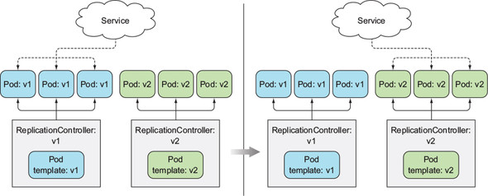
BLue Green Deployment

Slide 5
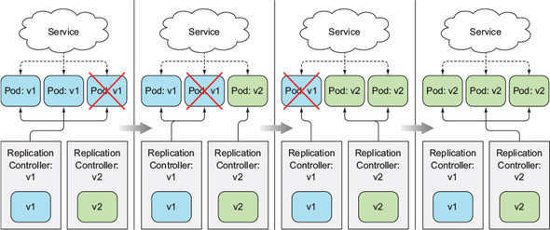
Rolling update using RC

Slide 6
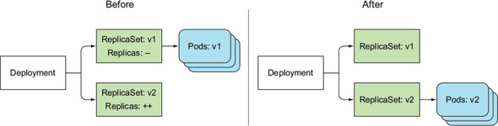
A Deployment at the start and end of a rolling update

Slide 7
THANK YOU
Let us know how can we help your organization to Upskill the employees to stay updated in the ever-evolving IT Industry.
Get in touch:
www.zekeLabs.com | +91-8095465880 | info@zekeLabs.com
Visit : www.zekeLabs.com for more details

